Slide 1
Google Cloud Platform
Cloud Services

Slide 2
Evolution (from On-Premises Servers To Cloud Computing Solutions)
Email
Facebook …
Drop Box

Slide 3
State of Existing Infrastructure
Functionality (speed of Product development)
Reliability
Scalability (Future)
Security (Cloud Security Concerns)
Cost
Ease of Use

Slide 4
Cloud Provider Companies
Top three:
Amazon web Services
Microsoft Azure
Google Cloud Platform
Other:
IBM
Oracle
Alibaba
Google is such a developer focused cloud
Google expect people to have a developer background when working in the GCP
AWS is DevOps cloud (Network admin & DBAs)

Slide 5
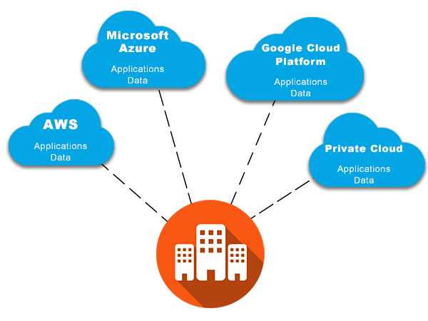
Data storage option in the cloud
Multi-Cloud Is Possible
Option Include:
Amazon S3
Azure Blob Storage
Google Cloud Storage

Slide 6
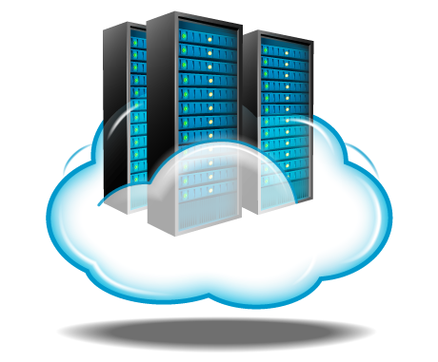
Virtual Servers in the Cloud (IAAS)
Option include:
Amazon EC2
Azure Virtual Machines
Google Compute Engine

Slide 7
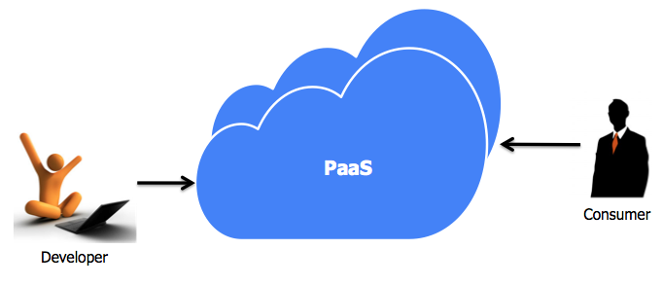
Platform as a Service (PAAS)
Option include:
Google App Engine
Microsoft App Service
Amazon Elastic Beanstalk

Slide 8
IAAS , PAAS , Deploy App … Whats next?
Analyzing Data
Big – Data
Option include:
Amazon Redshift
Google bigQuery
Azure SQL Data Warehouse
Machine Learning
Makes predictions or recommendations based on data
Artificial Inteligence
Helps computers add value to human tasks , machine translation and visual recognation

Slide 9
Some Other Cloud Services
Real-Time Data Streaming and Processing
Option include:
Amazon Kinesis
Google Cloud Dataflow
Azure Stream Analytics
Data Analysis and Visualization
Option include:
Google Data Studio
Amazon Athena
Azure Analysis Services
Making Predictions and Recommendations
Option include:
Google Cloud Machine Learning Engine
Amazon Machine Learning
Azure Machine Learning

Slide 10

Cloud Administration Tools
Basic major administration tools
User management
Billing management
Monitoring

Slide 11

Business Regulations
Cloud Usage across Industries (Finance , Healthcare , Government)
Security and Privacy Processes
Identity and access management (IAM) in the cloud
Data Encryption
General Data Protection Regulation (GDPR) to data security and privacy
Health Insurance Portability and Accountability
Adapting to Changes

Slide 12
GCP Context & Services
GCP

Slide 13
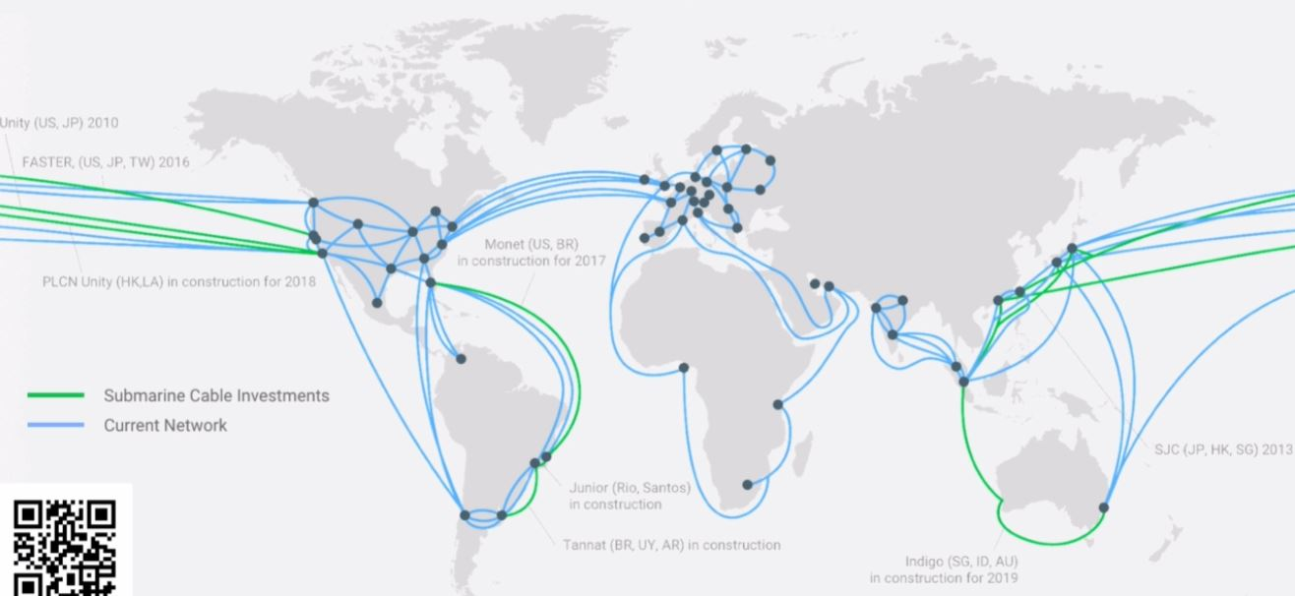
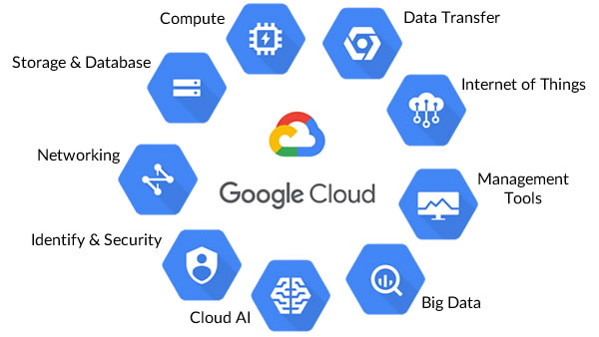
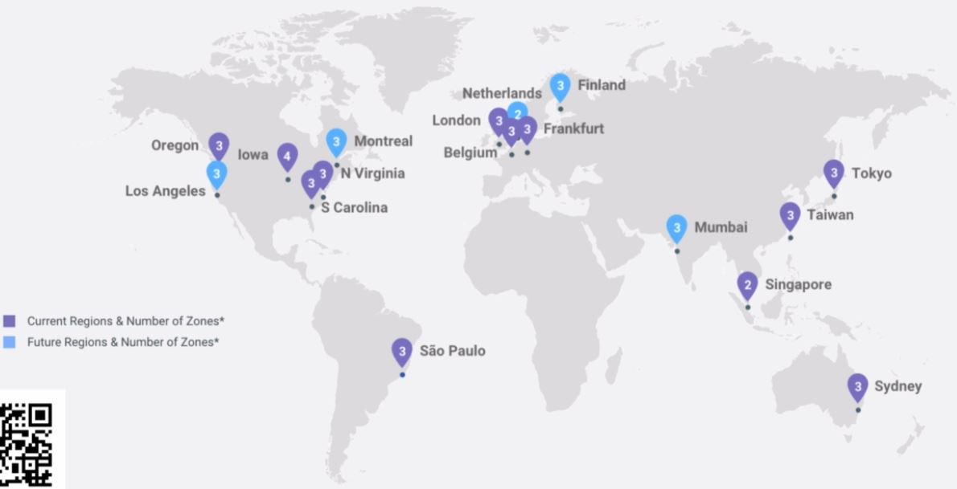
GCP Structure & Design
GCP is intrinsically GLOBAL : the services are generally built to serve worldwide customers

Slide 14
Services at a glance
1- Compute Production
2- Storage Products
3- DataBase Products
4- Data and Analytics Products
5- AI and Machin Learning Products
6- Networking Products
7- IOT Products
8- Identity and Security Products
9- Management tools Product
10- Developer Tools
11- Migration (to GCP)
12- API Platform and Ecosystems
13- Google maps Platform
14- G Suite Platform
15- Mobile Products
16- GCP Foundational Open Source Projects

Slide 15
Compute Products
GCP

Slide 16
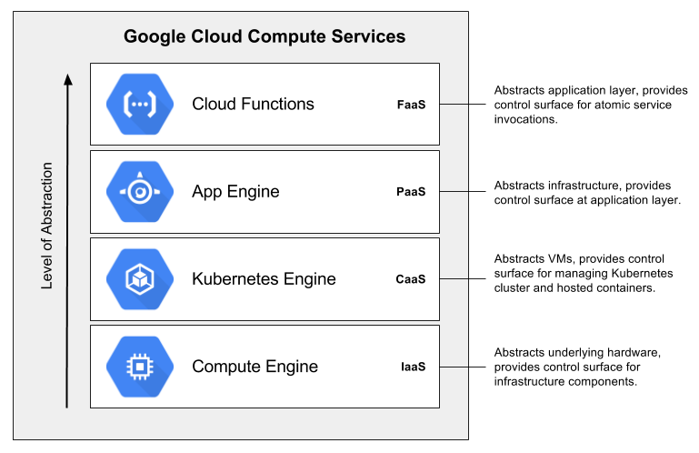
Compute Products
1- Compute Engine : Virtual Machines , Disk , Network
2- App Engine : Managed App Platform
3- Kubernetes Engine : Managed K8s/Containers
4- Cloud Functions : Event-driven serverless functions

Slide 17
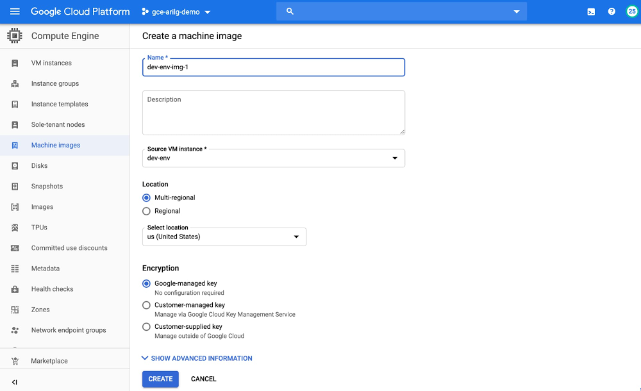
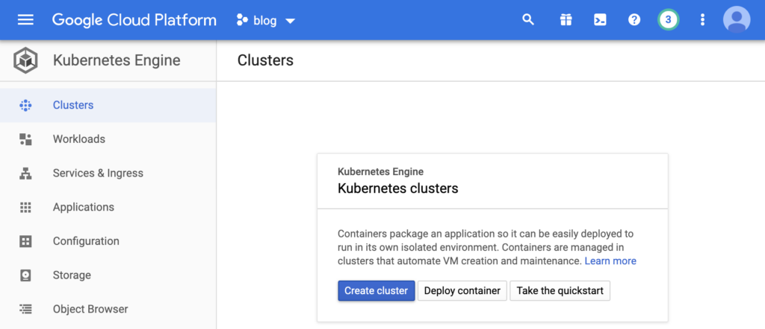
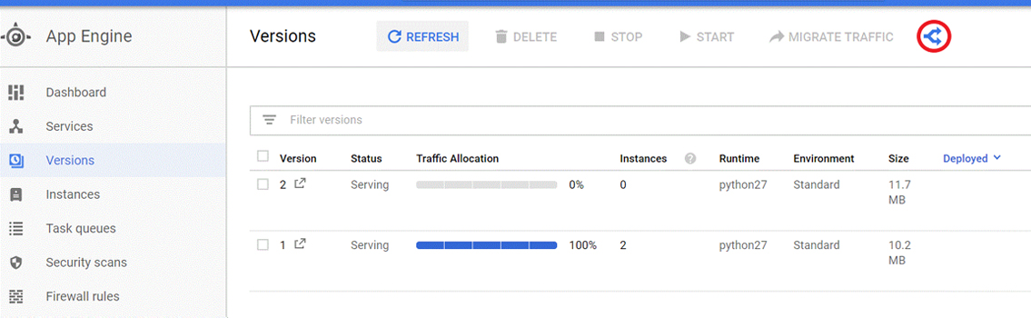

Slide 18
Storage Products
GCP

Slide 19
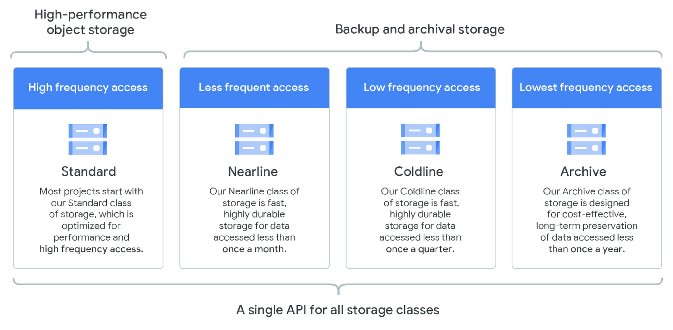
Storage Products
Cloud Storage : Object Storage and serving
Nearline : Archive Occasional Access Storage
Coldline : Archive Rare Access Storage
Persistent Disk : VM-Attached Disk
Cloud Filestore : Managed NFS server

Slide 20
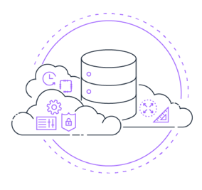
DataBase Products
Cloud Bigtable : Petabyte-scale , low-latency , nonrelational
Cloud Datastore : Horizontally Scalable Document DB
Cloud Firestore : Strongly-consistent Serverless Document DB
Cloud Memorystore : Managed Redis
Cloud Spanner : Horizontally Scalable Relational DB
Cloud SQL : Managed MYSQL and PostgreSQL

Slide 21
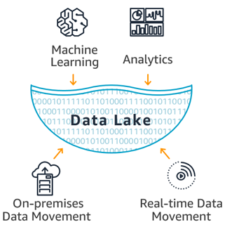
Big Data and Analytics Products
Cloud composer : Managed Workflow Orchestration Service
Cloud Dataflow : Stream/batch data processing
Cloud Datalab : Managed Jupyter Notebook
Cloud Dataprep : Visual data wrangling
Cloud dataproc : Managed Spark and Hadoop
Cloud pub/sub : Global Real-time Messaging
Google BigQuery : Data Warehouse/Analytics
Google Data Studio : Collaborative Data Exploration/Dashboarding
Google Genomics : Managed Genomics Platform

Slide 22

AI and Machine Learning Products
Cloud AutoML Natural Language : Custom text classification models
Cloud AutoML Translate : Custom domain-specific translation
Cloud AutoML Vision : Custom image classification models
Cloud job Discover : job search with ML
Cloud Deep Learning VM image : Preconfigured VMs for deep learning
Cloud Machine Learning Engine : Managed Platform for ML
Cloud Natural Language : Text Parsing and Analysis
Cloud Speech-to-text : Convert Audio to text
Cloud Text-to-speech : Convert text to Audio
Cloud TPU : Specialized Hardware for ML
Cloud Translation API : Language Detection and Translation
Cloud Video Intelligence : Scene-level Video Annotation
Cloud Vision API : Image Recognition and Classification
Dialogflow Enterprise Edition : Create Conversational interface

Slide 23
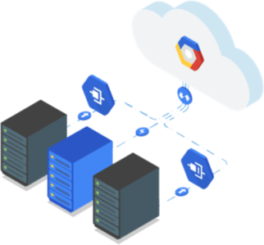
Networking Products
Carrier Peering : Peer with a carrier
Direct Peering : Peer with GCP
Dedicated Interconnect : Dedicated private network connection
Partner Interconnect : Connect on-premises network to VPC
Cloud Armor : DDOS Protection
Cloud CDN : Content Delivery Network
Cloud DNS : Prpgrammable DNS serving
Cloud Load Balancing : Multi-region Load Distribution
Cloud NAT : Network Address Translation Service
IPsec VPN : Virtual private network connection
Network Service Tiers : Price vs Performance Tiering
Network Telemetry : Network Telemetry Service
Virtual Private Cloud : Software Defined Networking

Slide 24
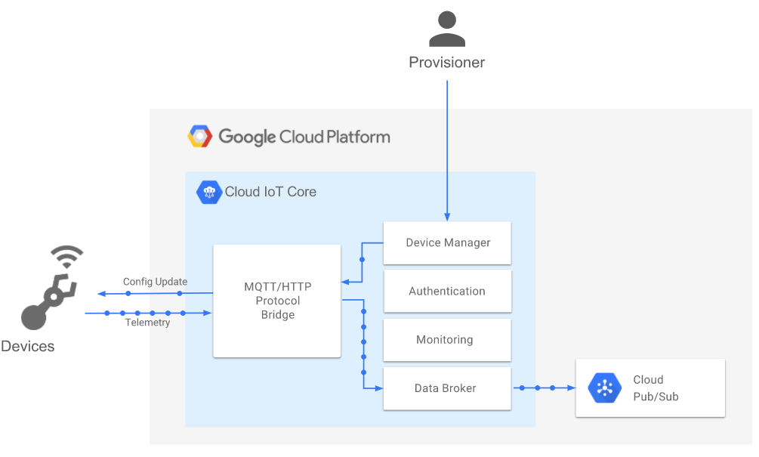
Internet Of Things Product
Cloud IOT Core : Device Management and ingest data

Slide 25
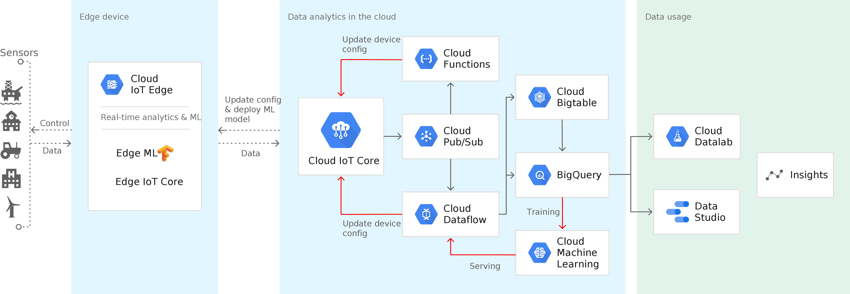

Slide 26
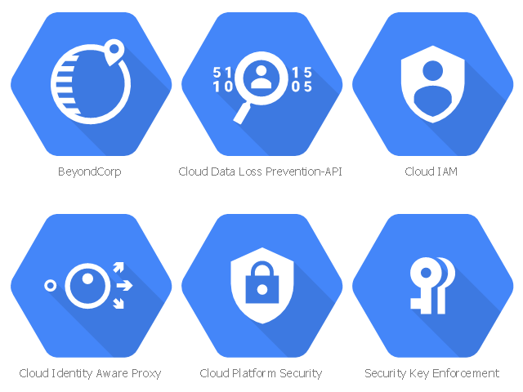
Identity and Security Products
Access Transparency : Audit Cloud Provider Access
Binary Authorization : Kubernetes Deploy-time Security
Cloud Data Loss Prevention API : Classify , Redact Sensitive Data
Cloud HSM : Hardware Security Module Service
Cloud IAM : Resource Access Control
Cloud Identity : Manage User , Devices & Apps
Cloud Identity-Aware Proxy : Identity-based App Signin
Cloud key Management Service : Hosted key Management Service
Cloud Resource Manager : Cloud Project Metadata Management
Cloud Security Scanner : App Engine Security Scanner
Security Key Enforcement : Two-step Key Verification
Shielded VMs : Hardened VMs
Titan Security Key : Two-factor Authentication (2FA) Device

Slide 27
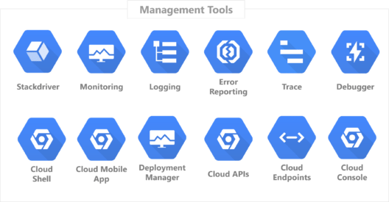
Management Tools Product
Cloud APIs : APIs for Cloud Services
Cloud Billing : Billing and Cost Management Tools
Cloud Billing API : Programmatically Manage GCP Billing
Cloud Console : Web-based Management Console
Cloud Deployment Manager : Templated Infrastructure Deployment
Cloud Mobile App : ios/Android GCP Manager App
Cloud shell : Browser-based Terminal/CLI
Stackdriver Debugger : Live Production Debugging
Stackdriver Error Reporting : App Error Reporting
Stackdriver Logging : Centralized Logging
Stackdriver Monitoring : Infrustructure and Application Monitoring
Stackdriver Profiler : CPU and heap profiling
Stackdriver Transparent SLIs : Monitor GCP Services
Stackdriver Trace : App Performance Insights

Slide 28
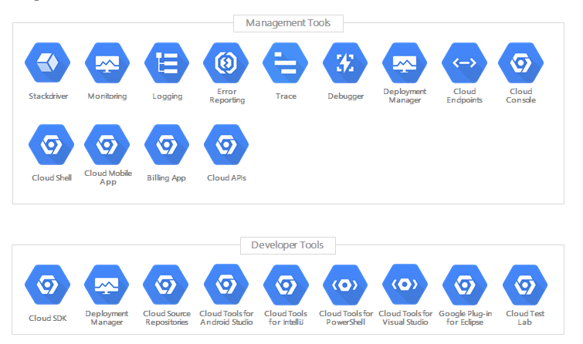

Slide 29
Developer Tools
Cloud SDK : CLI for GCP
Cloud Build : Continuous integration/delivery platform
Cloud Source Repositories : Hosted Private Git Repos
Cloud Scheduler : Managed cron job service
Cloud Tools for IntelliJ : IntelliJ GCP Tools
Cloud Toos for PowerShell : PowerShell GCP Tools
Cloud Tools for Visual Studio : Visual Stadio GCP Tools
Cloud Tools for Eclipse : Eclipse GCP Tools
Container Registry : Private Container Registry/Storage
Gradle App Engine Plugin : Gradle App Engine Plugin
Maven App Engine Plugin : Maven App Engine Plugin

Slide 30
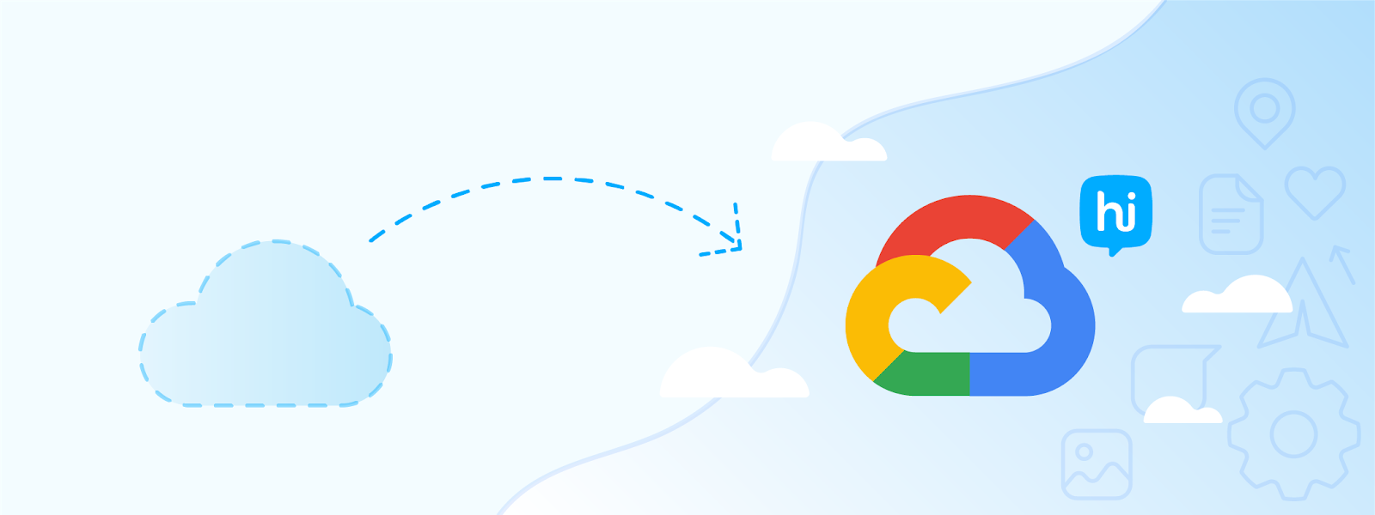
Migration (To GCP)
Google Translate Appliance : Rentable Data Transport Box
Cloud Storage Transfer Service : Cloud to Cloud Transfers
BigQuery Data Transfer Services : Bulk Import Analytics Data
Velostrata : Lift-and-shift VM Migration

Slide 31
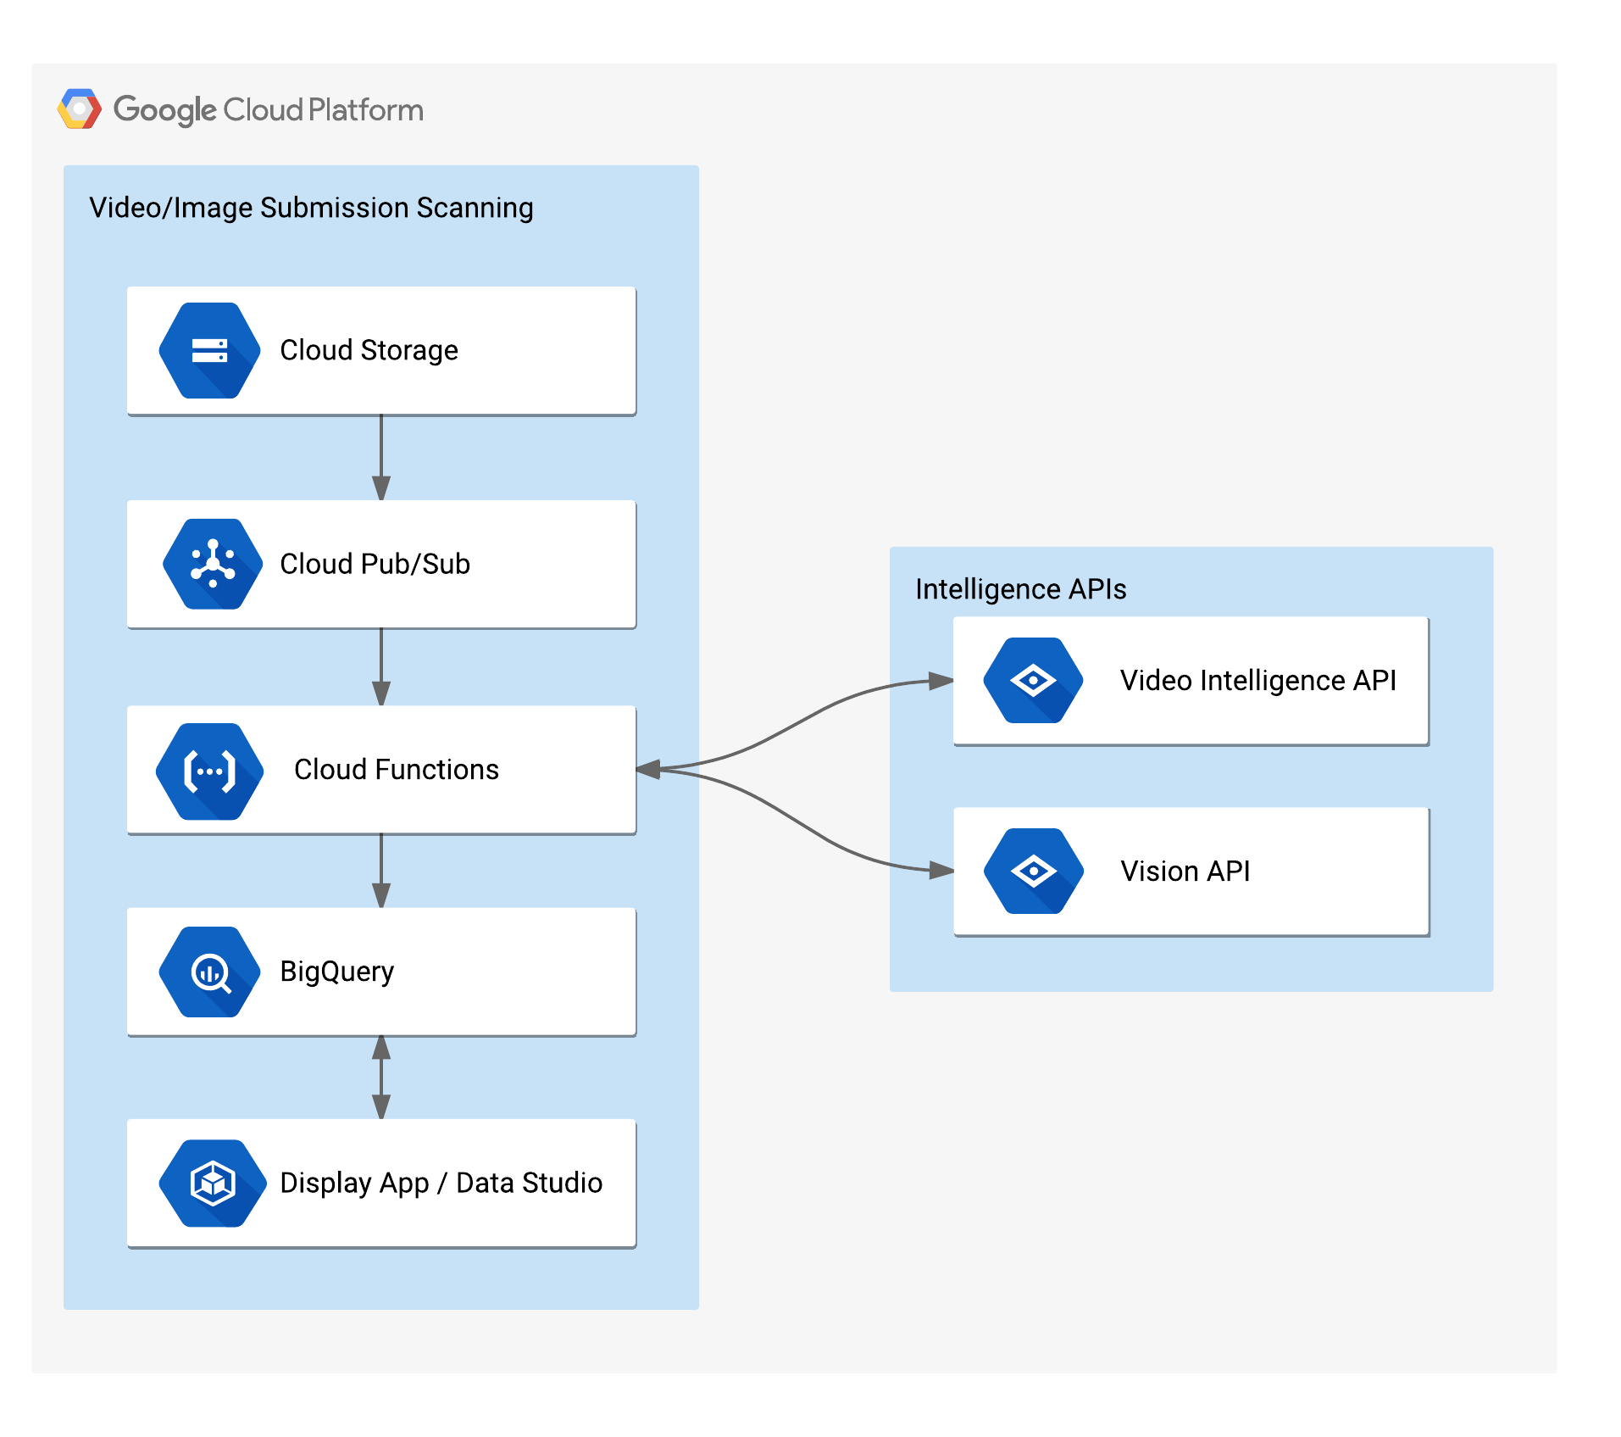
API Platform and Ecosystem (Open API!)
Bource , Bank , …
API Analytics : API Metrics
API Monetization : Monetiza APIs
Apigee API Platform : Develop , secure , monitor APIs
Apigee Sense : API protection from attacks
Cloud Endpoints : Cloud API Gateway
Cloud Healthcase API : Healthcare System GCP Interoperability
Developer Portal : API Management Portal
GCP Marketplace : Partner & Open Source Marketplace

Slide 32
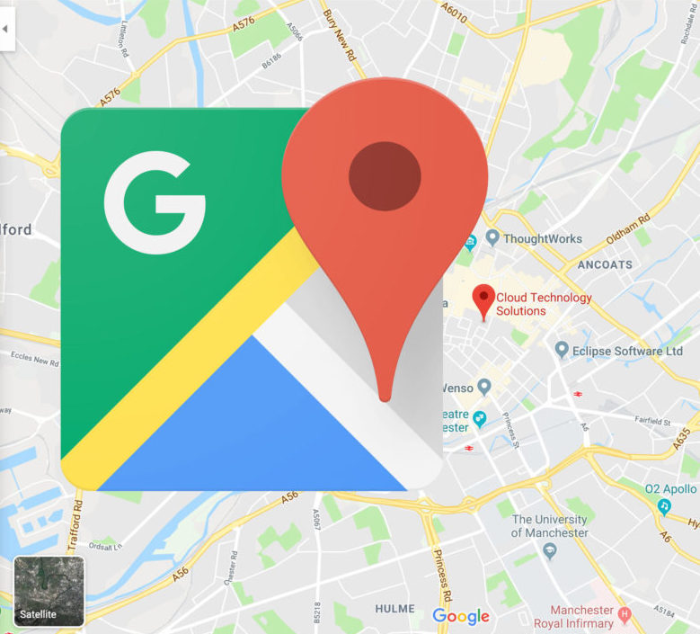
Google Maps Platform
Directions API : Get Directions Between Locations
Distance Matrix API : Calculate Travel Times
Geocoding API : Convert Address to/from Coordinates
Geolocation API : Derive Location Without GPS
Maos Embed API : Web Embedded Maps
Maps JavaScript API : Dynamic Web Maps
Maps SDK for ios/Android
Maps Static API : Web static Maps
Maps Unity SDK : Unity SDK for Games
Maps URLs : URL Scheme for Maps
Places API : Metadata About Places (Rest)
Places Library , Maps JS API : Metadata About Places (JavaScript)
Places SDK for ios/Android
Roads API : Metadata About Roads
Street View API
Time Zone API : Convert Coordinates to Timezone

Slide 33
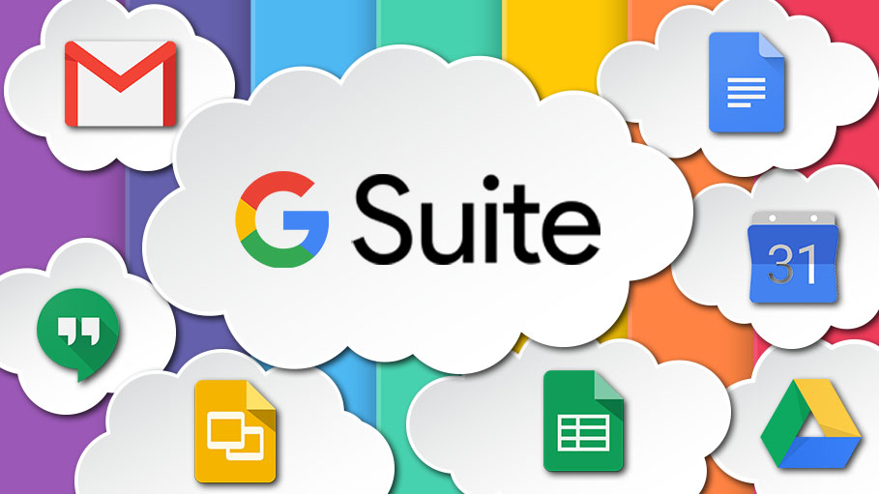
G Suite Platform
App Maker : Assistive App Building
App Script : Extend and Automate Everything
Editor Add-ons : Extend Docs , Sheets , Slides
Gmail Add-ons : Contextual Apps in Gmail
Hangouts Chat Bots : Conversational Bots in Chat
Calendar API : Create and Manage Calendars
Classroom API : Provision and Manage Classrooms
Drive API : Read and Write Files
Gmail API : Enhance Gmail and Inbox
Sheets API : Read and Write Spreadsheets
Slides API : Create and Edit Presentation
Drive Picker : Drive File Selection Widget
Admin SDK : Manage G Suite Setting
Email Markup : Interactive Email using Schema.org
G Suite Marketplace : Storefront for Integrated Applications

Slide 34
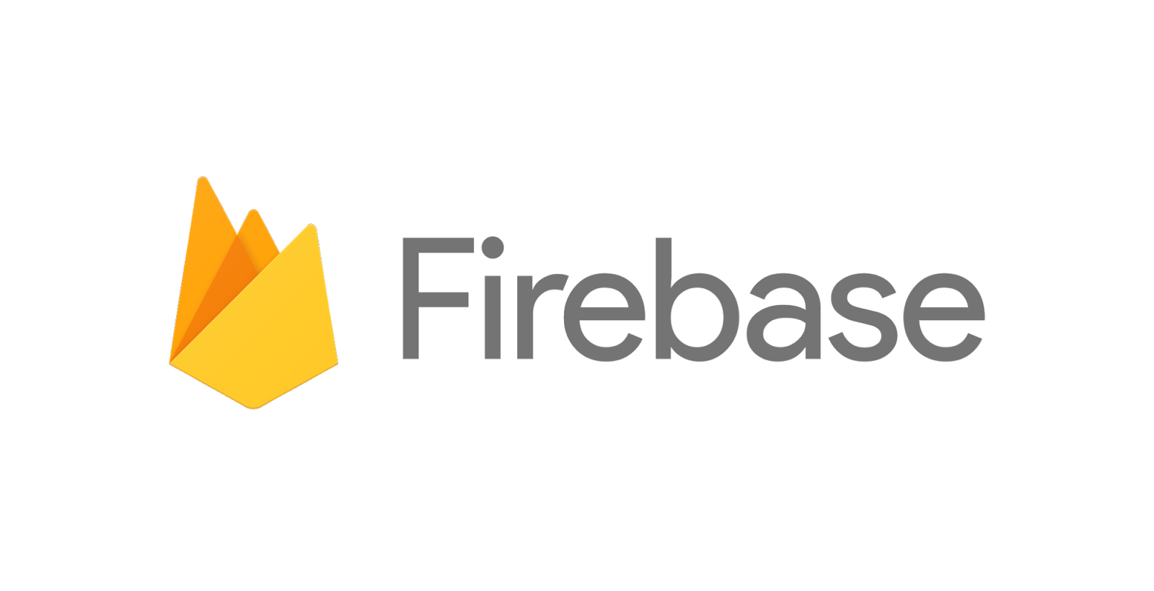
Mobile Products
Cloud Firestore : Document Store and Sync
Cloud Functions for Firebase : Event-driven Serverless Applications
Cloud Storage for Firebase : Object Storage and serving
Crashlytics : Crash Reporting and Analytics
Firebase A/B Testing : Create A/B Test Experiments
Firebase App Indexing : App / Google Search Integration
Firebase Authentication : Drop-in Authentication
Firebase Cloud Messaging : Send Device Notifications
Firebase Dynamic Links : Link to App Content
Firebase Hosting : Web Hosting with CDN/SSL
Firebase in-App Messaging : Send contextual Message In-App
Firebase Performance Monitoring : App Performance Monitoring
Firebase Predictions : Predict User Targetting
Firebase Realtime Database : Real-time Data Synchronization
Firebase Remote Config : Remotely Configure Installed Apps
Firebase Test Lab : Mobile testing device farm
Google Analytics for Firebase : Mobile App Analytics
ML Kit fro Firebase

Slide 35






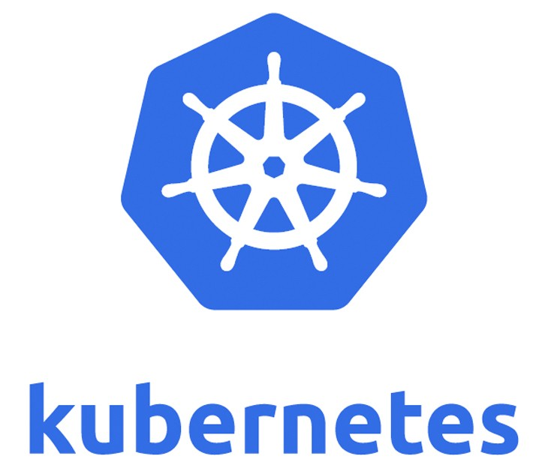


GCP Foundational Open Source Projects
Apache Beam : Batch/Streaming Data Processing
gRPC : RPC Framework
gVisor : Secure Container Runtime
Istio : Connect and Secure Services
Knative : Serverless framework for Kubernetes
Kubeflow : ML Toolkit for Kubernetes
Kubernetes : Management of containerized Applications
OpenCensus : Cloud Native Observability Framework
TensorFlow : ML Framework

Slide 36

THANKs…

